Slide 2
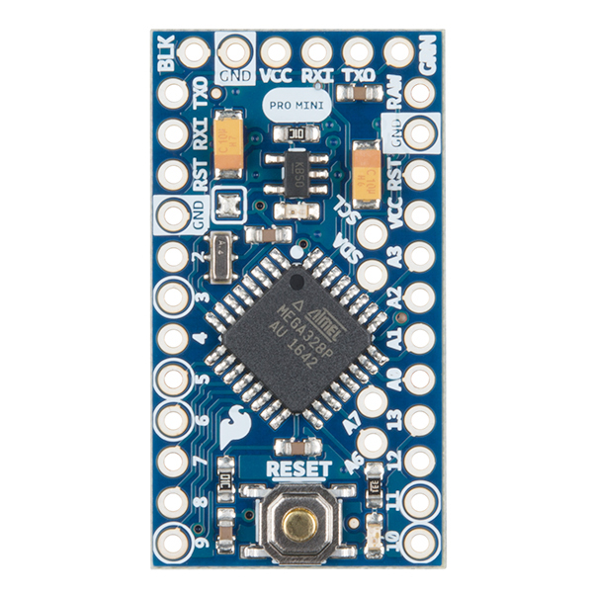
Components
Arduino pro mini:
The Arduino Pro Mini is a microcontroller board based on the ATmega328.
It has 14 digital input/output pins (of which 6 can be used as PWM outputs), 6 analog inputs, an on-board resonator, a reset button, and holes for mounting pin headers.

Slide 3
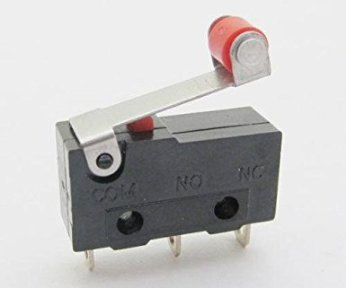
End stop switch:
An end stop switch is basically a low friction switch which can easily be turned on with force, in this case the force of a head.
It is a mechanical switch

Slide 4
ADVANTAGES:
Cheap
Easy to work with
reliable
DISADVANTAGES:
Limited number of on/off cycles
Needs new ways to mount thee switch, without destroying the connections.

Slide 5
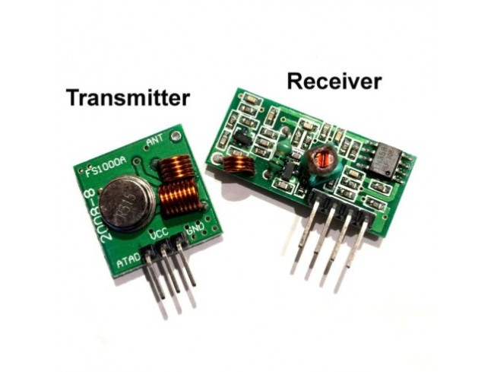
TRANSMITTER AND RECEIVER:
The main job is to communicate whether all the switches are closed. The signals transmitted by the transmitter are taken up by the receiver in the receiver module.
It has a range of about 10 metres depending upon the voltage supplied to it.

Slide 6
ADVANTAGES:
Low cost
Sufficient range
Easy setup

Slide 7
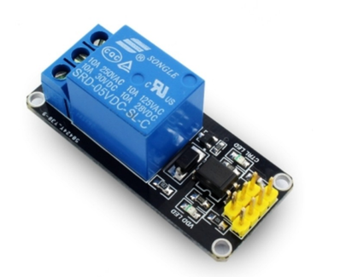
RELAY:
A relay is an electromagnetic switch operated by a relatively small electric current that can turn on or off a much larger electric current. The heart of a relay is an electromagnet (a coil of wire that becomes a temporary magnet when electricity flows through it). This connects to the bike.

Slide 8
MULTIPLE SOLUTIONS
1)PRESSURE SENSOR
A pressure sensor is a device which senses pressure and converts it into an electric signal whose magnitude depends upon the pressure applied. Since they convert pressure into an electrical signal, they are also termed as pressure transducers.
DISADVANTAGES
They are not easy to see full scale or trending.
They are not able to read oscillating values.
They require power.
as the pressure increases, the resistance goes down.

Slide 9
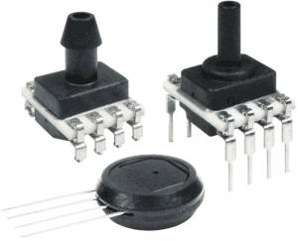
APPLICATIONS
Pressure sensing
Altitude sensing
Flow sensing
Level / depth sensing
Leak testing

Slide 10
2)FORCE SENSING RESISTORS
A force-sensing resistor is a material whose resistance changes when a force, pressure or mechanical stress is applied. They are also known as force-sensitive resistor.
As the pressure increases, the resistance goes down. But they're rarely accurate. They also vary some from sensor to sensor . So basically when you use FSRs you should only expect to get ranges of response.

Slide 11
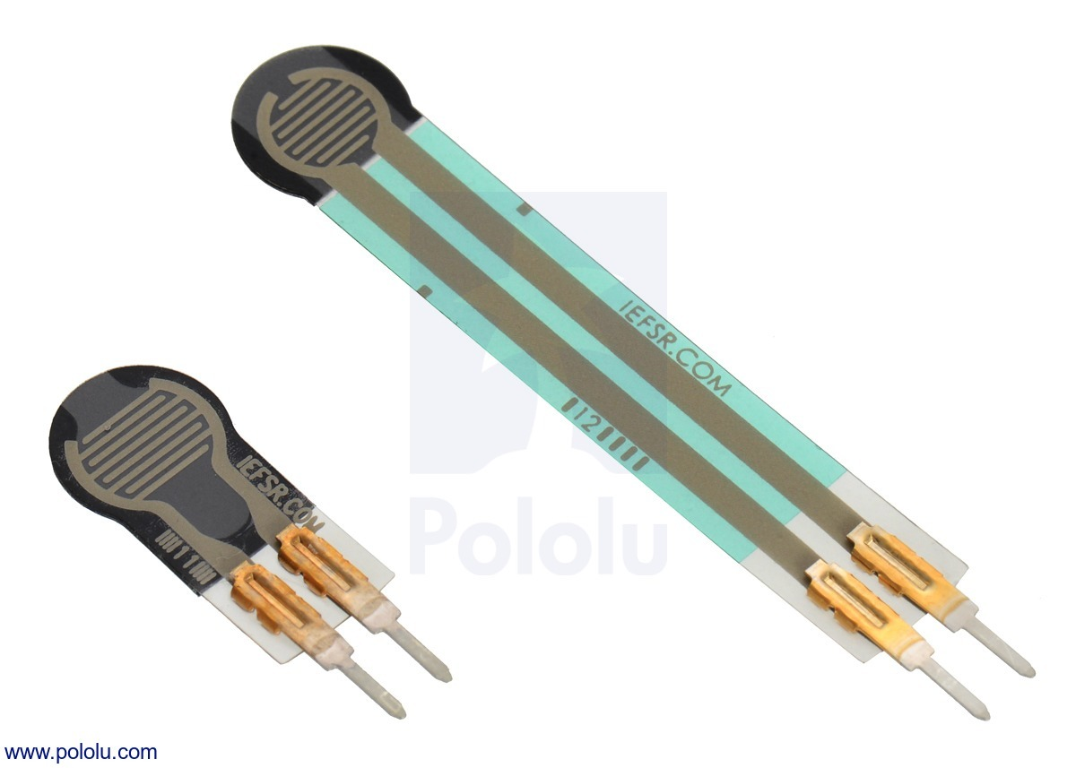
APPLICATIONS
Force-sensing resistors are commonly used to create pressure-sensing "buttons" and have applications in many fields, including musical instruments, artificial limbs.

Slide 12
3)INFRARED SENSORS
An infrared sensor is an electronic instrument which is used to sense certain characteristics of its surroundings by either emitting and/or detecting infrared radiation. Infrared sensors are also capable of measuring the heat being emitted by an object and detecting motion

Slide 13
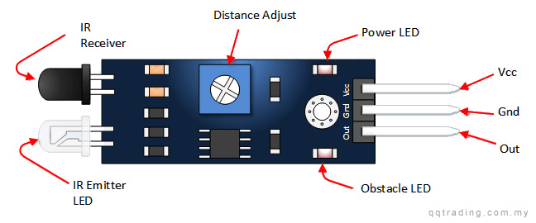
APPLICATIONS
Night Vision Devices
Infrared Tracking
Climatology
Meteorology
Gas detectors
Water analysis
Rail safety

Slide 14
4)PROXIMITY SENSORS
A proximity sensor is a sensor able to detect the presence of nearby objects without any physical contact. A proximity sensor often emits an electromagnetic field or a beam of electromagnetic radiation and looks for changes in the field or return signal.
Their operating principle is based on a coil and oscillator that creates an electromagnetic field in the close surroundings of the sensing surface
But the drawback of this solution is that it requires light and its tough to incorporate light inside the helmet.

Slide 15
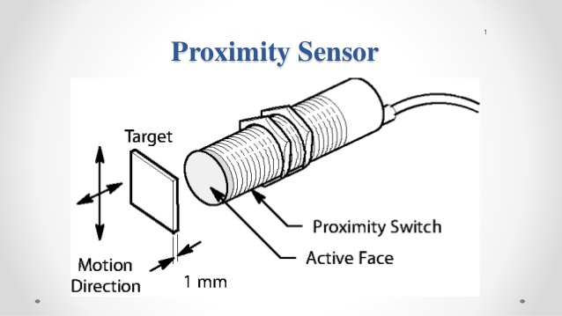
APPLICATIONS
Position Measurement
Detecting Dynamic Motion
Touchpads
Assembly Testing
Ground Proximity Warning System
Air Gauging

Slide 16
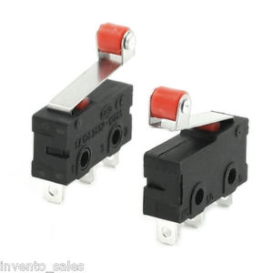
5)END STOP SWITCH
Mechanical switches are less complicated to implement because they do not require a circuit board and only use 2 wires for connecting the switch. Pull up and down resistors can be put close to the main board.

Slide 17
ADVANTAGES
Switches are the cheapest endstops in most cases.
No need for opto pcb.
Simple switches can be used on x and y axis.
You could even make your own contact switch from a few pieces of metal.
You get to solder stuff.

